Slide 1
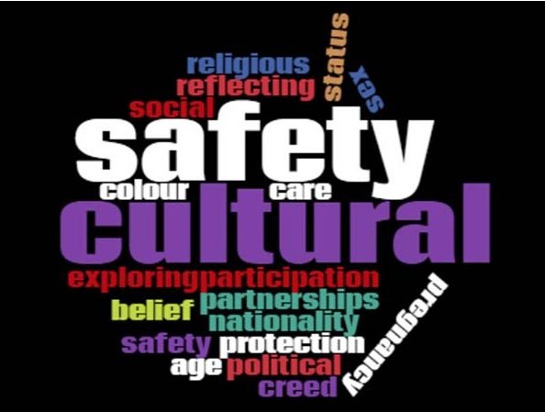

INDG6002 Health and Indigenous Peoples
Cultural Safety
Week 4 Tutorial

Slide 2
Warning
This presentation may include images, voices, stories, and names of deceased people now resting in the Dreaming that may cause sadness or distress to Aboriginal and Torres Strait Islander students.

Slide 3
Overview
What does cultural safety mean to you?
In this module, we will look at the origins and meaning of Cultural Safety and provide a rationale for why this is an effective framework for working with Aboriginal and Torres Strait Islander peoples.
Five core principles of Cultural Safety are described and discussed in detail.
There are a range of terms used when working with culturally diverse groups and it is easy to be distracted by the terminology (e.g. cultural competency, cultural awareness).
This module will focus on Cultural Safety and Culturally safe practice and how these apply to your professional practice when working with Aboriginal and Torres Strait Islander peoples.

Slide 4
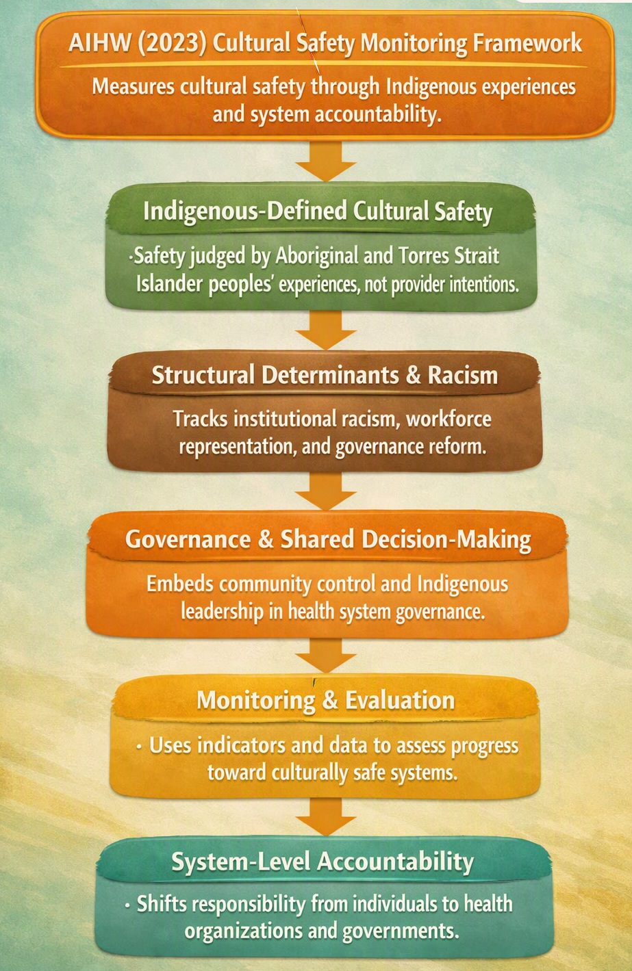
Mapping Module to grass-roots, community-led Indigenous frameworks and approaches
Australian Institute of Health and Welfare (AIHW) 2023 Cultural Safety Monitoring Framework

Slide 5
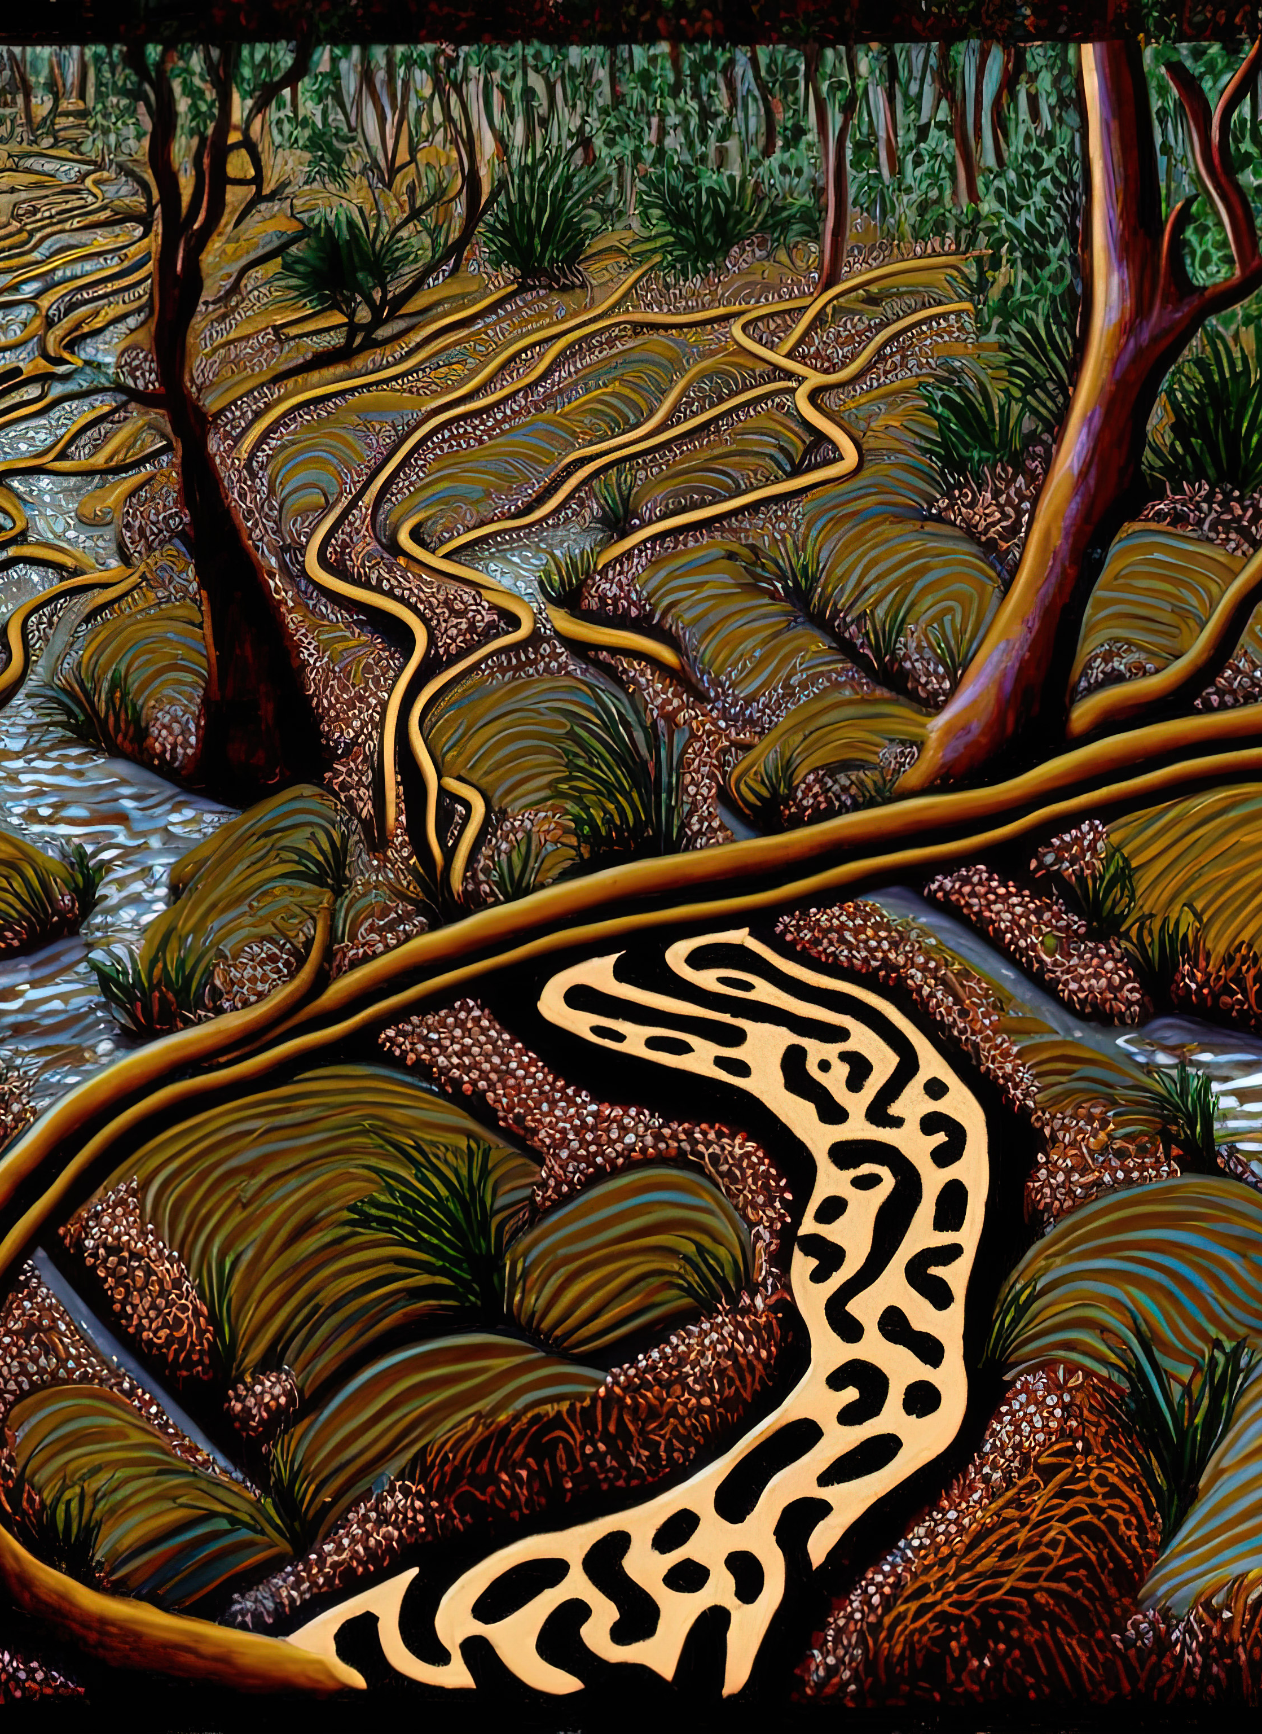
Frameworks of Healthcare - Curtin, Robinson and Dulvarie 2019
Chapter 3 - Aboriginal and Torres Strait Islander Peoples' Health & Wellbeing Biles & Biles (Eds)
Prioritise Aboriginal and Torres Strait Islander peoples voices/knowledges
Support tertiary curricula to prepare graduates to provide culturally safe services
Improve trust in the health system by Aboriginal and Torres Strait Islander peoples
Ensure Western health providers understand that, for Aboriginal and Torres Strait Islander peoples, health is holistic and linked to culture and community.
Emphasise the importance of community leadership and involvement in developing health responses and ensuring that efforts are community-driven and appropriate
Providing a structured approach to care that is sensitive to the diversity of Aboriginal and Torres Strait Islander peoples

Slide 6

Communication style
Appearance
Beliefs & Assumptions
Values
Expectations
Attitudes
Culture – Visible/Invisible

Slide 7
Recap - Culture affects health
Important to know:
Culture impacts upon our health, values, and health beliefs and practices
Our diet and cultural eating patterns
Physical activity
Child rearing practices
Reactions to pain
Reactions to birth, death and stress
You need to know because you will work with people from many different and diverse cultural backgrounds

Slide 8

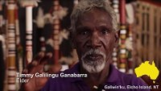
Culture – Aboriginal perspective

Slide 9
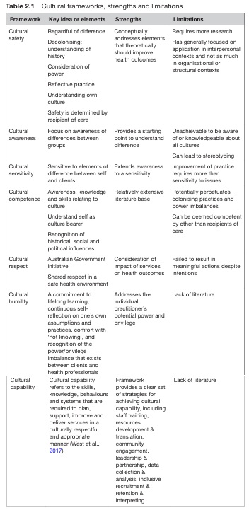
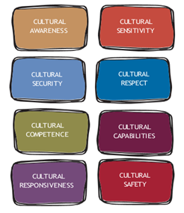
Cultural Frameworks

Slide 10
Transcultural Nursing: Early Approach to Culture in Health Care
Developed in the 1960s, influenced by anthropology and Madeleine Leininger’s work
First nursing model to integrate cultural considerations into health care practice
Focused on teaching health professionals about cultural differences
Culture was narrowly defined as ethnicity or race
Nurses learned cultural protocols for clients from different ethnic or religious backgrounds
Limitation: risk of relying on stereotypes about behaviour based on ethnicity

Slide 11

Origins of Cultural Safety
Cultural safety emerged from the work of Māori nurse Irihapeti Ramsden.
This was in response to her concerns at witnessing the discriminatory and inequitable treatment of her people within the Aotearoa/New Zealand health system

Slide 12

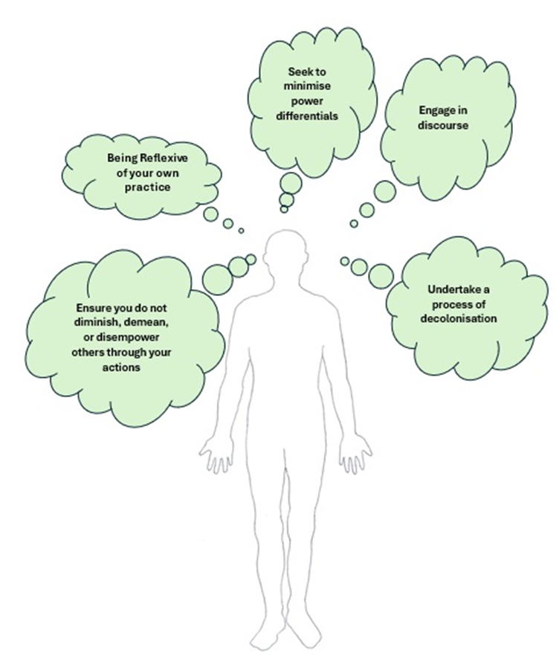
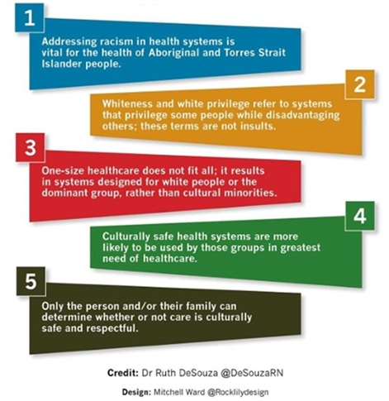
5 Cultural Safety Principles
5 Facts about Cultural Safety

Slide 13
Cultural Safety – An Aboriginal and Torres Strait Islander Perspective
Discussing and addressing cultural safety in Australia is essential because racism and the enduring effects of colonisation continue to drive significant health disparities for Aboriginal and Torres Strait Islander peoples. (Mohamed et al.,2024)
As previously stated in this unit, racism and lack of cultural safety drives Indigenous Peoples fear and avoidance of health and social services. Lack of trust between Indigenous Peoples and western provided health and social services has a strong colonial history (Gatwiri, Rix, & Rotumah, 2021).

Slide 14
AHPRA and Cultural Safety in Australia
Australian Health Practitioner Regulation Agency (AHPRA) regulates over 800,000 health practitioners.
Cultural safety is now a guiding principle in the National Law and embedded in professional codes of conduct.
AHPRA’s Aboriginal and Torres Strait Islander Health and Cultural Safety Strategy 2020–2025 aims to:
Eliminate racism in healthcare.
Make clinical and cultural safety inseparable.
Ensure cultural safety is defined by Aboriginal and Torres Strait Islander Peoples.
Cultural safety is reinforced through:
Mandatory education and CPD frameworks.
Accreditation standards for health programs.
Monitoring and reporting systems.
Indigenous Leadership at the core
AHPRA’s cultural safety initiatives are Indigenous-led, ensuring Aboriginal and Torres Strait Islander voices shape policy and practice.

Slide 15

What is Reflexivity?
“The sector often uses the term reflexivity, which is like reflection. Simply, reflection leads to insight about something, whereas reflexivity involves finding strategies to question our ‘attitudes, values, assumptions, prejudices, and habitual actions’. Reflexivity helps us understand how we contribute to the dynamic with others.”​
Victorian State Government. (2024) p. 38​
Image: fidel-fernando--PGr1H-Ua7U-unsplash

Slide 16
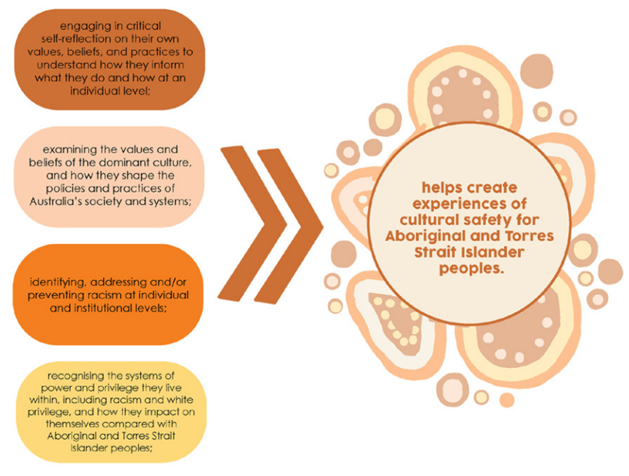
Reflexivity and Actions
Image: Gollan & Stacey 2021, p. 14

Slide 17
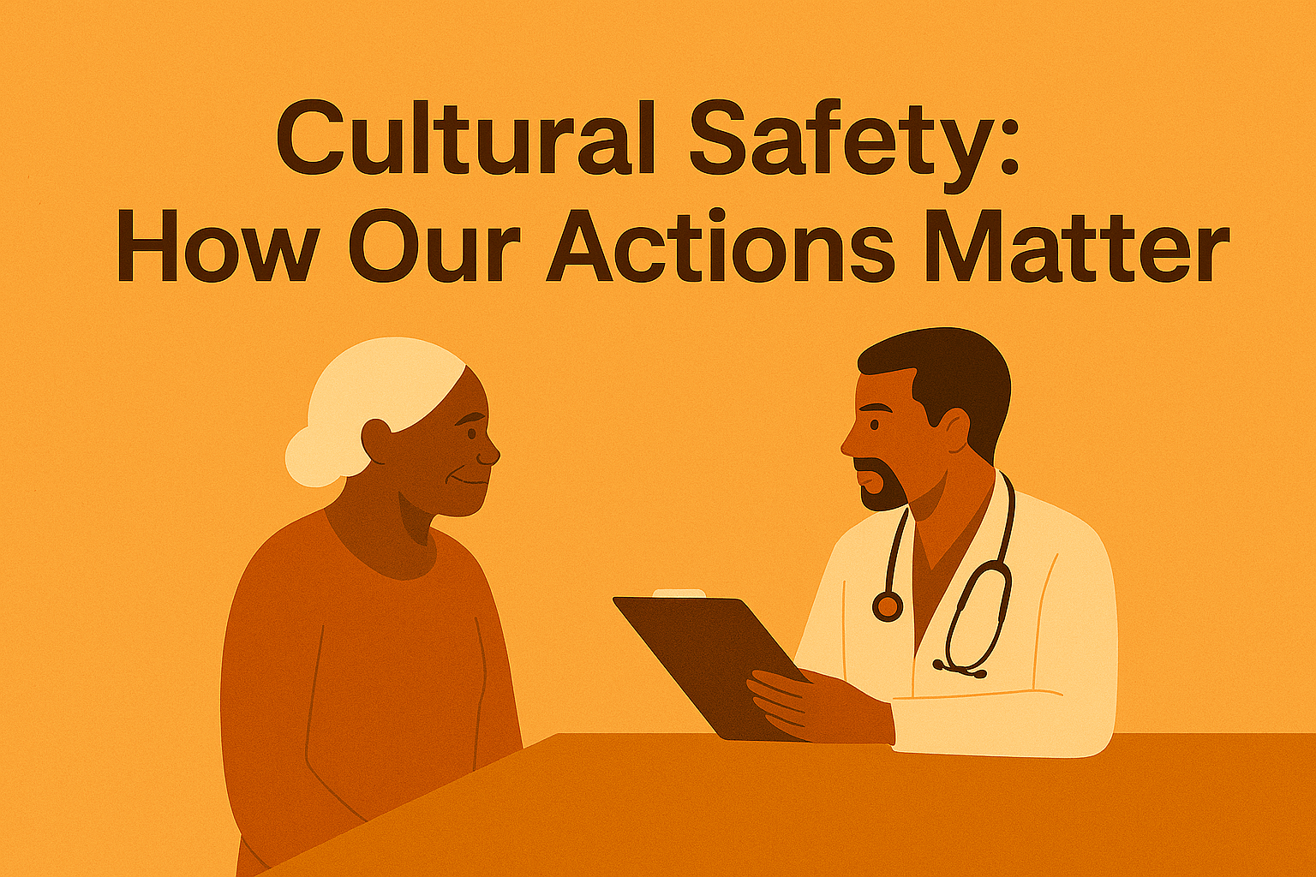
Scenario
An elderly Aboriginal patient comes to the clinic with her daughter. The health professional speaks quickly, uses medical words that are hard to understand, and talks only to the daughter. The patient looks confused and quiet.
“What might the patient be feeling?”
List 3 things the health professional could do to make the interaction more culturally safe.

Slide 18
Translation to Practice
Understand the importance of cultural safety
1
Be respectful
2
Acknowledge your own inadequacies, and the things you do not know
3
Develop a trusting relationship with the patient/client, the Indigenous health workers, and the community
4
Be mindful of your attitude, behaviour and communication (both verbal and non-verbal) at all times.
5

Slide 19
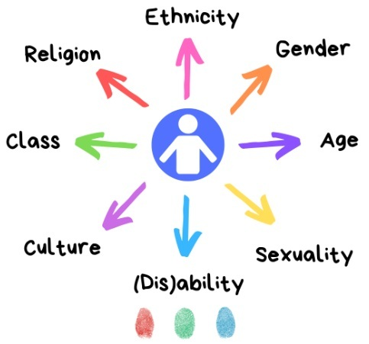
Othering: The ‘flip side’ of Cultural Safety
Othering can be seen by actions such as:
thinking that people outside your social/cultural group are not as intelligent or skilled as you and this is then reflected in your actions and tone of language
ignoring people’s ideas or opinions
not giving people, the benefit of the doubt
failing to share vital information with others
excluding others

Slide 20
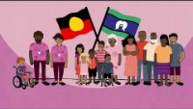
Cultural safety and the National Principles for Child Safe Organisations
10 National Principles for Child Safe Organisations Guide link: https://www.childsafety.gov.au/resources/keeping-our-kids-safe-cultural-safety-and-national-principles-child-safe-organisations-guide-0
SNAICC - https://www.snaicc.org.au/

Slide 21
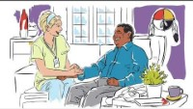
International perspective
Link: https://www.youtube.com/watch?v=cLDkA2RIeCM

Slide 22
Marumali Journey of Healing Program
What Happened:
Aunty Lorraine Peeters created a healing program for Stolen Generations survivors.
Activities include truth‑telling, identity work, kinship reconnection, and cultural mentoring.
Healing is led by Elders and survivors.
Culture is treated as medicine.
Safe spaces are created through cultural protocols.
Why It Matters:
Client‑determined care: Safety defined by the client.
Critical self‑reflection: Staff examine bias and privilege.
Anti‑racism: Confronting institutional racism.
Indigenous leadership: Elders guide care.
Truth‑telling: Central to healing and cultural safety.
Strengths‑based practice: Focus on resilience and cultural pride.
Cultural safety: Holistic, empowering, community‑controlled care.
https://marumali.com.au/our-programs/

Slide 23
Warning
This presentation includes images, voices, stories, and names of deceased people now resting in the Dreaming that may cause sadness or distress to Aboriginal and Torres Strait Islander students.

Slide 24
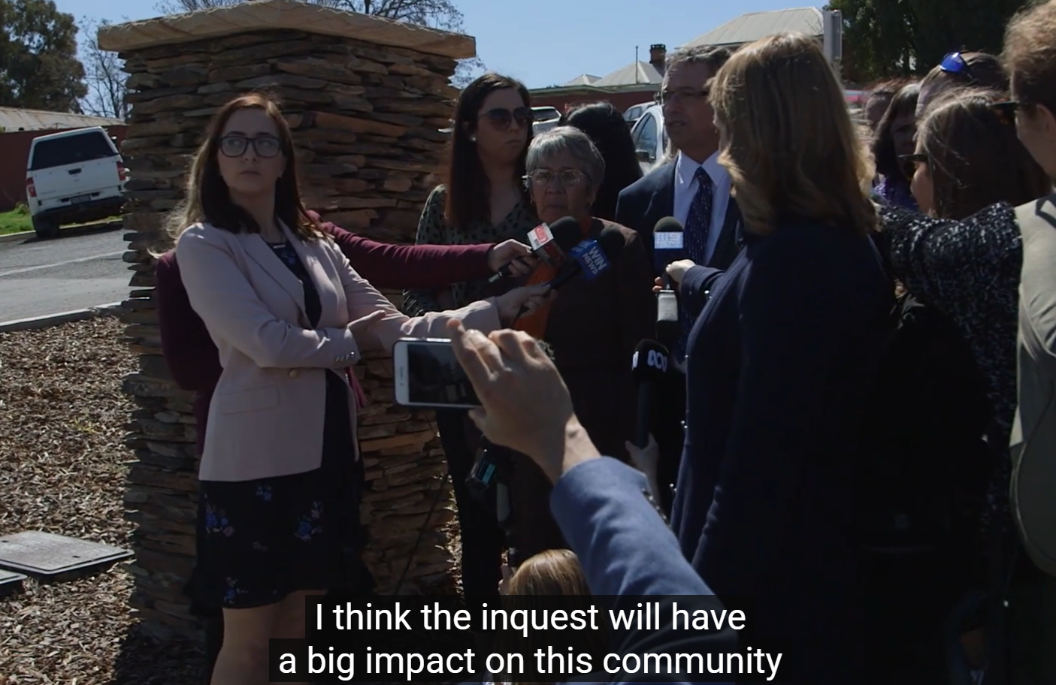
SBS Report on Naomi Williams(Oct,2018)
Naomi Williams was a 27-year-old Wiradjuri (First Nations) woman, six months pregnant, who died in 2016 from sepsis.
She had visited the local rural hospital many times (reportedly 18 times in 8 months) for symptoms like severe pain, vomiting, and nausea.
Despite her repeated visits, she was given minimal treatment (in one instance, just two Panadol) and sent home without a proper assessment.
Experts at the inquest argued that there was implicit racial bias — hospital staff made stereotypical assumptions about her, including that she was a “drug seeker” because she had said she used marijuana
This stereotyping is linked to broader systemic racism in healthcare: for example, evidence was brought forward that Indigenous patients often receive fewer procedures than non-Indigenous patients

Slide 25
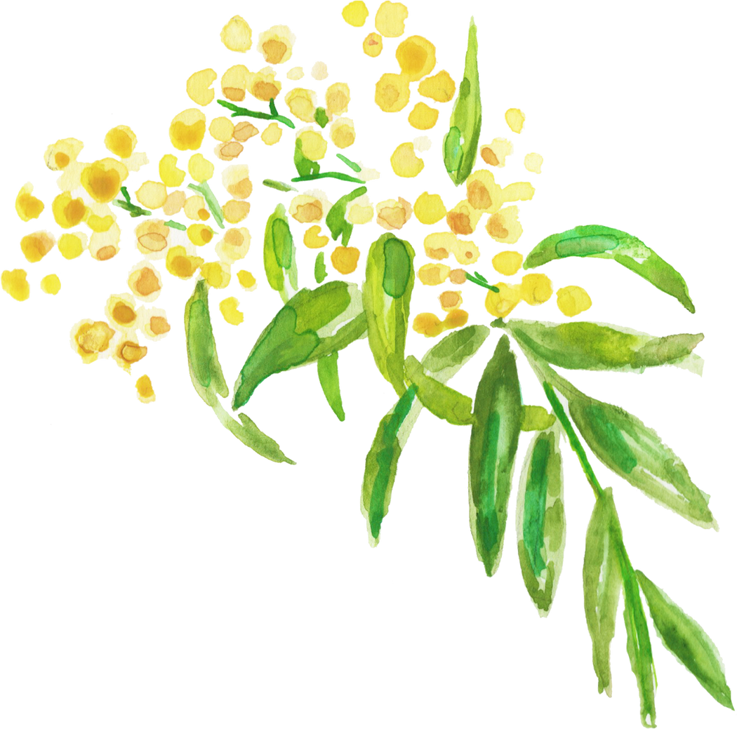
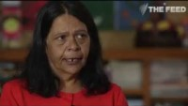
SBS Report on Naomi Williams (Oct, 2018)

Slide 26
Activity: Case Scenario
  David, an Aboriginal man, presents to the emergency department with chest pain. He is accompanied by a family member. The nurse begins asking clinical questions without introducing themselves or acknowledging the family. The nurse assumes David speaks English fluently and does not ask about language preferences or cultural needs. When David hesitates to answer, the nurse becomes impatient and says, “We need to hurry; this is serious.” The family member tries to speak, but the nurse dismisses them, saying, “We only need the patient’s answers.”
Discussion Questions :
1. What examples of culturally unsafe care can you identify in this scenario?
2. How could the nurse have provided culturally safe care?
3. What strategies would you use to minimise power imbalances and respect cultural protocols?
4. Reflect on your own practice: How would you ensure cultural safety in similar situations?

Slide 27
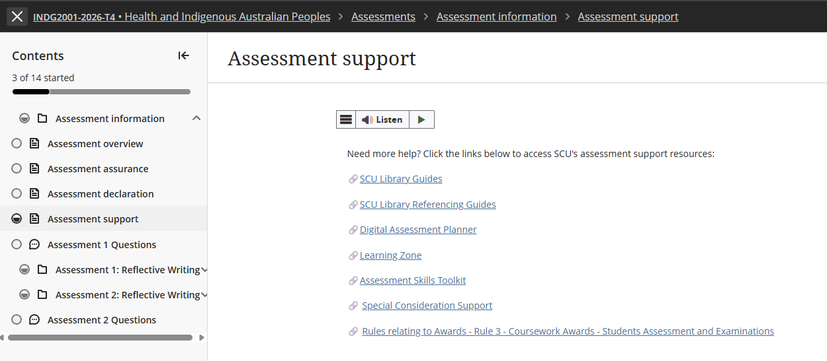
Requesting a Special Consideration Support extension

Slide 28
Assessment 2 – Critical Review
Title | Assessment 2
Type | Critical Review
Length | 2,200 words
Weighting | 60%
Academic Integrity | Level 2. Purpose-Specific GenAI Use GenAI may NOT be used EXCEPT Grammarly Premium AI.
Submission | Word document submitted to Blackboard
Unit Learning Outcomes | This assessment task maps to the following ULOs: 1. Discuss key concepts of health and wellbeing as determined by Aboriginal people 2. Identify key stages of the colonisation process and its relationship to the contemporary health status of Australian Indigenous people 3. Analyse the relationship between socio-economic factors and the contemporary health status of Australian Indigenous people 4. Explain how primary health care and/or health promotion enhances the wellbeing of Indigenous people and role of the health professional as an agent of social change

Slide 29
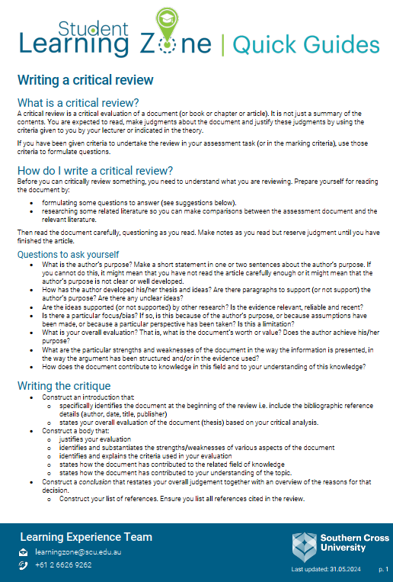
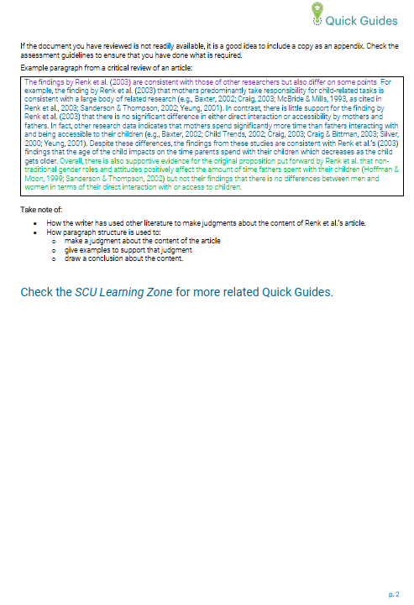
Writing a Critical Review
https://www.scu.edu.au/media/scu-dep/current-students/learning-zone/quick-guides/writing_a_critical_review.pdf

Slide 30
Critical Review of the Scenario
A critical review goes beyond description by examining why something happened, how it influences outcomes, and what it means in a broader context
In this assessment, you are not reviewing a written document—you are critically reviewing a scenario and practice interaction.
Instead of reading an article, you are examining:
  Sarah’s experiences
  The impacts of colonisation on her contemporary health
  the cultural context shaping the encounter
  the power dynamics in the consultation
  How primary health care and health promotion can respond

Slide 31
Critical Review of the Scenario
Judge the strengths and weaknesses (of the actions and recommendations in the scenario) – which must be evidence-based
Identify bias or assumptions - Analyse privilege, whiteness, and Western norms (how these assumptions affect Sarah’s wellbeing and care)
Overall evaluation - Judgement about the quality of practice - Must be linked to theory
A critical review always ends with a judgement.

Slide 32
Assessment 2 - Brief
Rationale – Why this assessment matters
Apply unit concepts to a realistic health care scenario
Critically examine culturally safe, strengths‑based, socially responsive practice
Analyse:
  SEWB concepts
  Impacts of colonisation
  Socioeconomic determinants
  Primary health care & health promotion
Shift away from deficit views → recognise strengths, resilience, cultural connections, self‑determination
Understand health professionals as agents of social change
Explore how culturally safe, equitable care supports Indigenous wellbeing
Assessment Task – What students must do
Write a critical review of the Sarah scenario
Examine how health professionals and services can support Indigenous health and wellbeing
Apply unit concepts to Sarah’s experiences and the clinic’s service improvements
Analyse culturally safe, strengths‑based approaches using scholarly evidence (min. 12 sources)
Evaluate the quality of practice → identify strengths, weaknesses, bias, assumptions
Provide evidence‑based recommendations for culturally safe care and SEWB‑aligned practice
Link all analysis to theory: SEWB, cultural safety, colonisation, determinants, PHC, health promotion

Slide 33
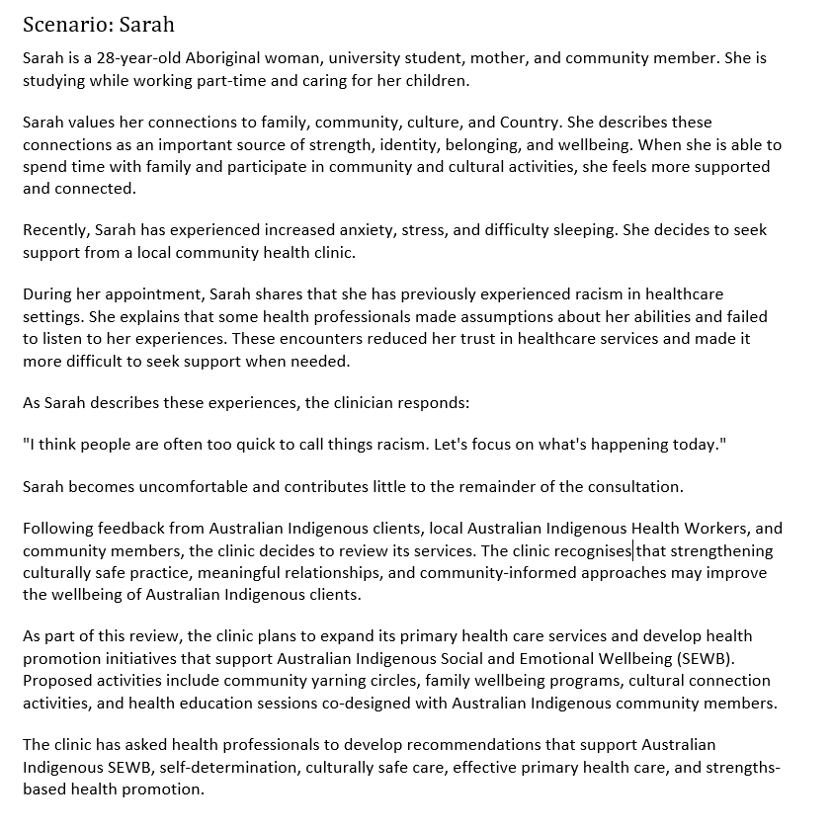
Assessment 2 Scenario

Slide 34
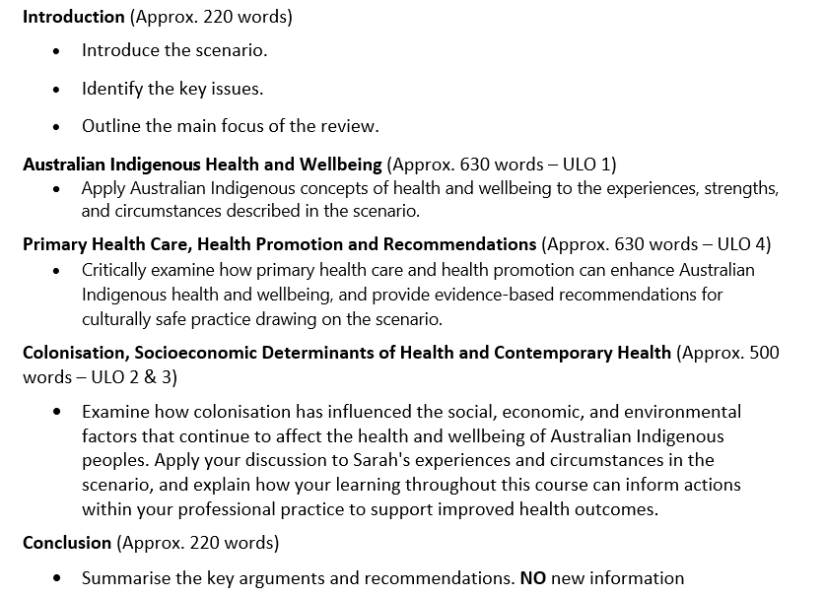
Example Assessment Structure

Slide 35
Your response must …
Assessment Requirements
Be written in a clear, coherent, and respectful academic style.
Support your discussion with evidence from:
  Scholarly literature
  Unit materials
  Definition of Scholarly and Peer-Reviewed sources
  Peer-reviewed sources are academic publications that have been evaluated by experts before publication to ensure quality, accuracy, and credibility. Scholarly sources are written by researchers or experts for an academic audience and include journal articles, academic books, conference papers, and theses. They typically provide author credentials and references. All peer-reviewed sources are scholarly, but not all scholarly sources are peer-reviewed. For example, an academic book may be scholarly without undergoing peer review.
Utilise evidence from a minimum of 12 scholarly sources to support your analysis
Use correct terminology and tone when referring to Australian Indigenous people
Use APA 7th document, referencing, and citation styles in this Unit
Label your submission with your surname and initials, and the assessment task's name, for example:
SmithJ_Critical Review.docx
You MUST add a footer to your submission.
Add your name and task type – i.e. SmithJ_CriticalReview on left margin, your student ID, and have page number on the right margin. See the example below:

Slide 36
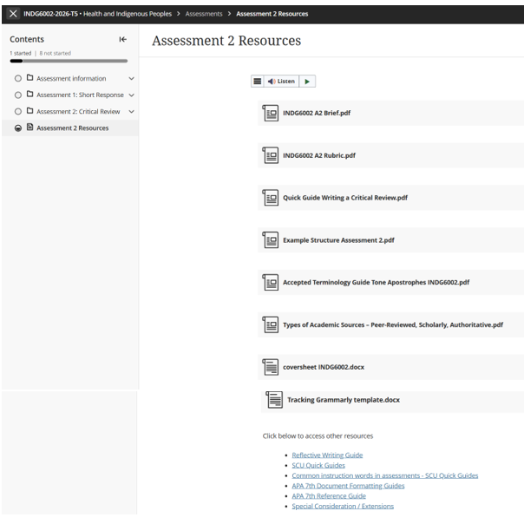
Task Resources & Other Requirements

Slide 37
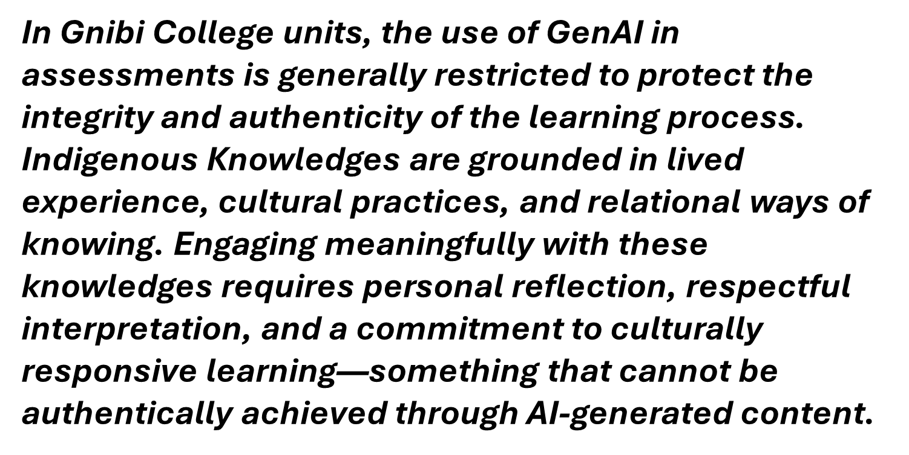
INDG6002 GenAI Use

Slide 38
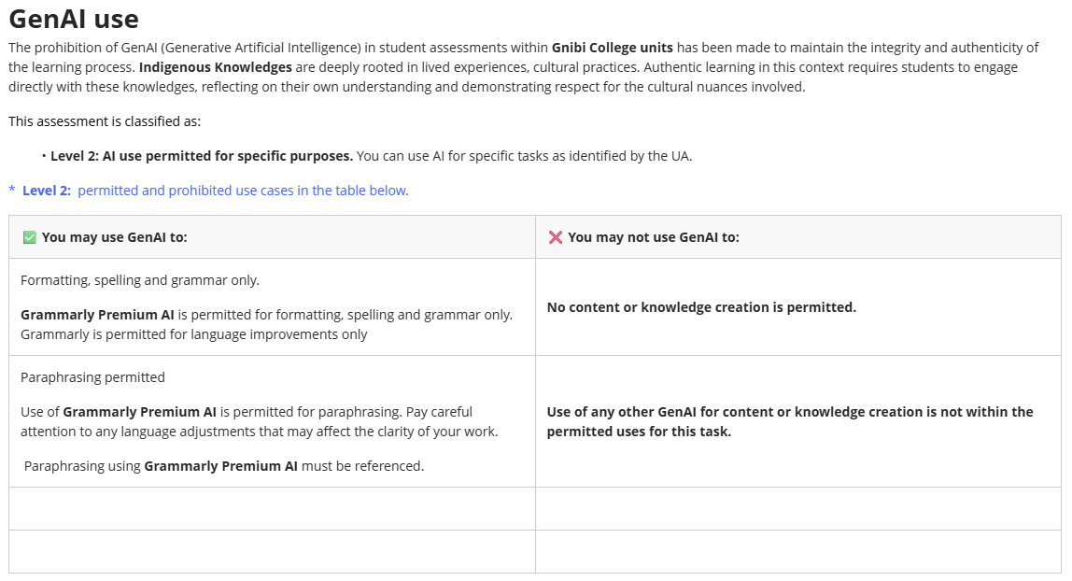
GenAI Use continued …

Slide 39
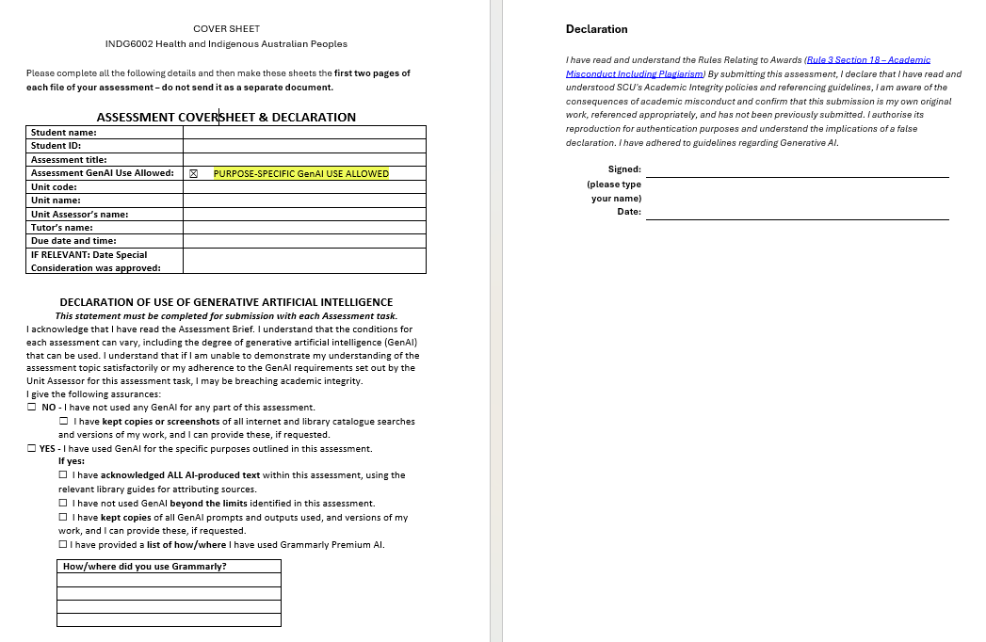
Coversheet & Declaration

Slide 40
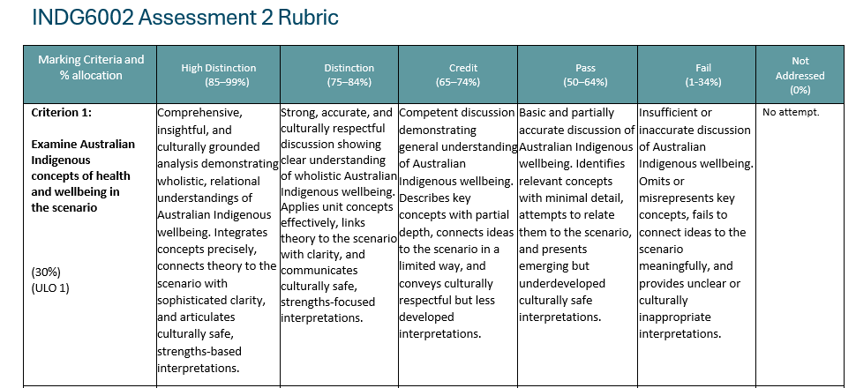
Assessment 2 - Rubric

Slide 41
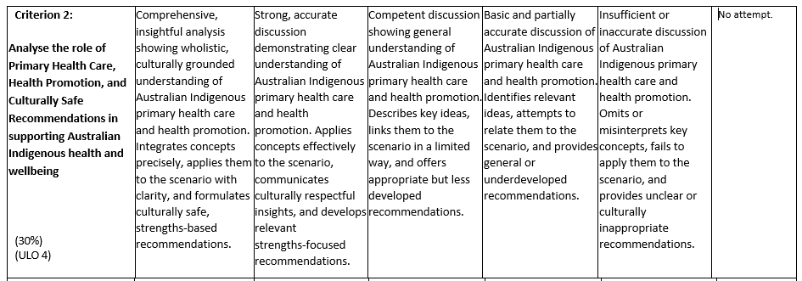
Assessment 2 - Rubric

Slide 42
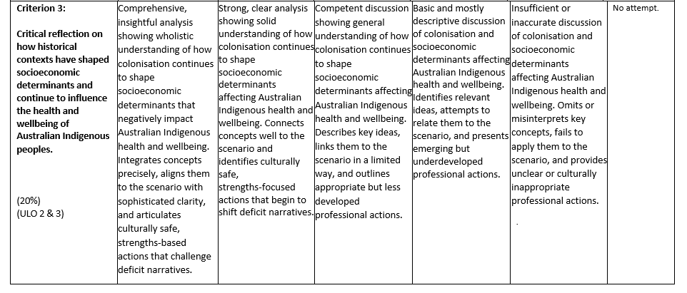
Assessment 2 - Rubric

Slide 43
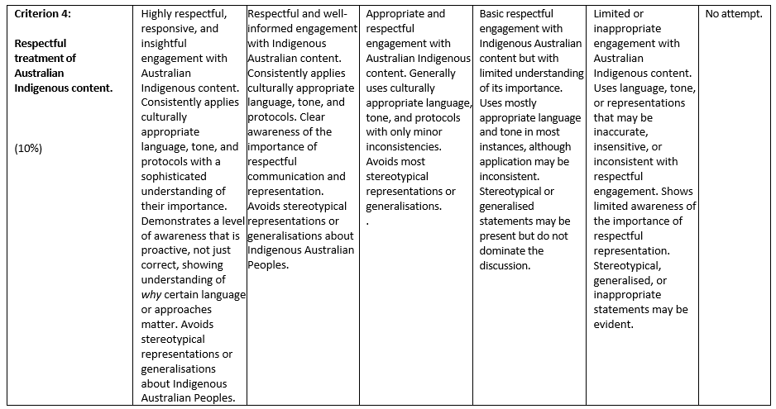
Assessment 2 - Rubric

Slide 44


Slide 45
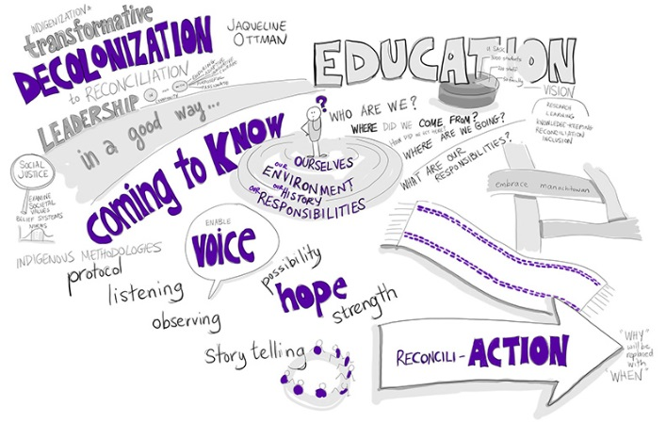
Next week …

Slide 46
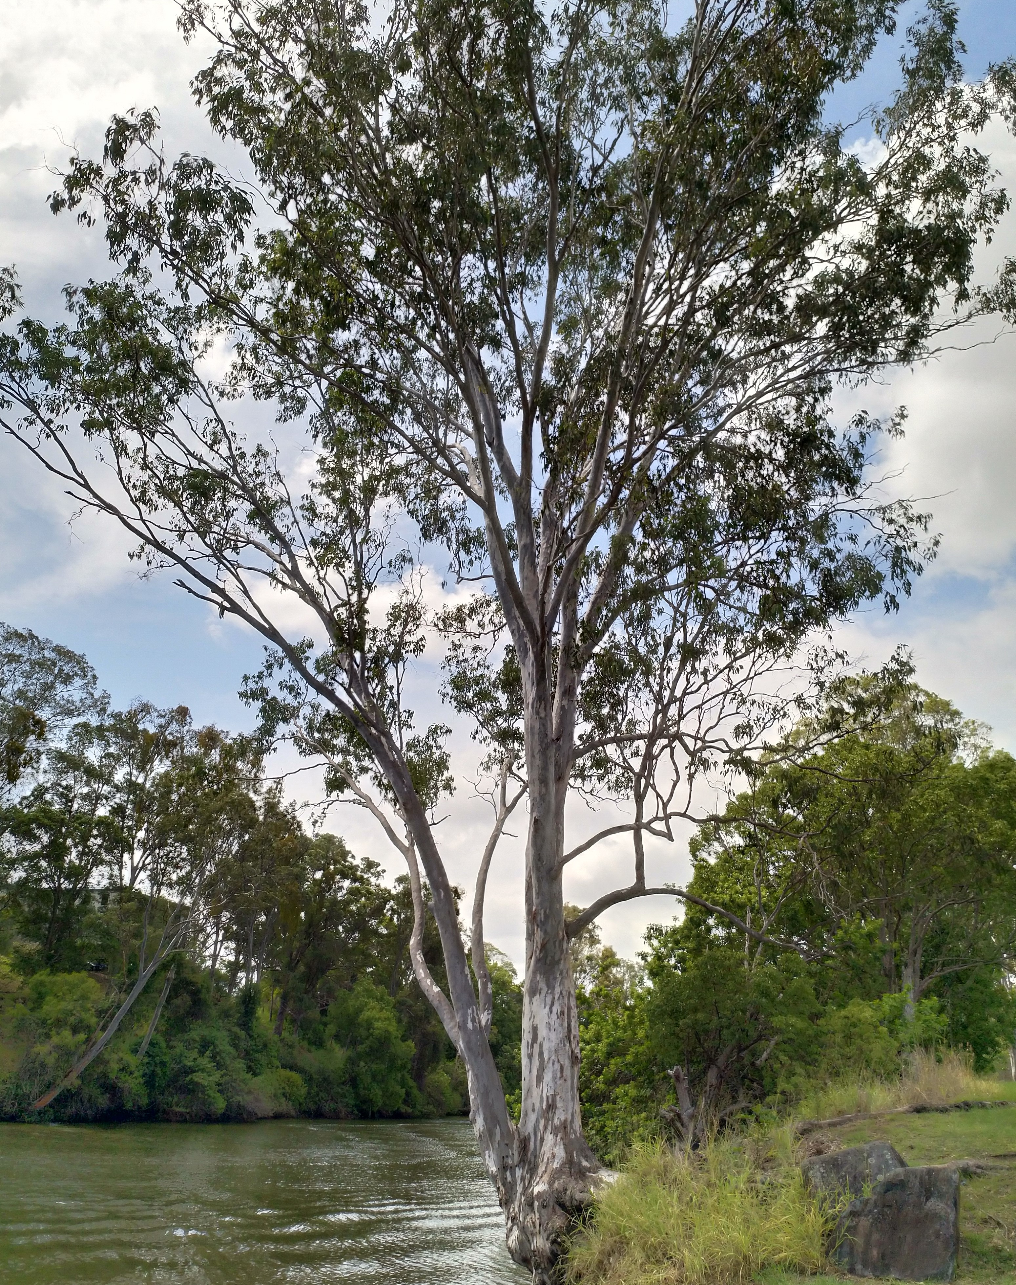
Until next time …

